Slide 1
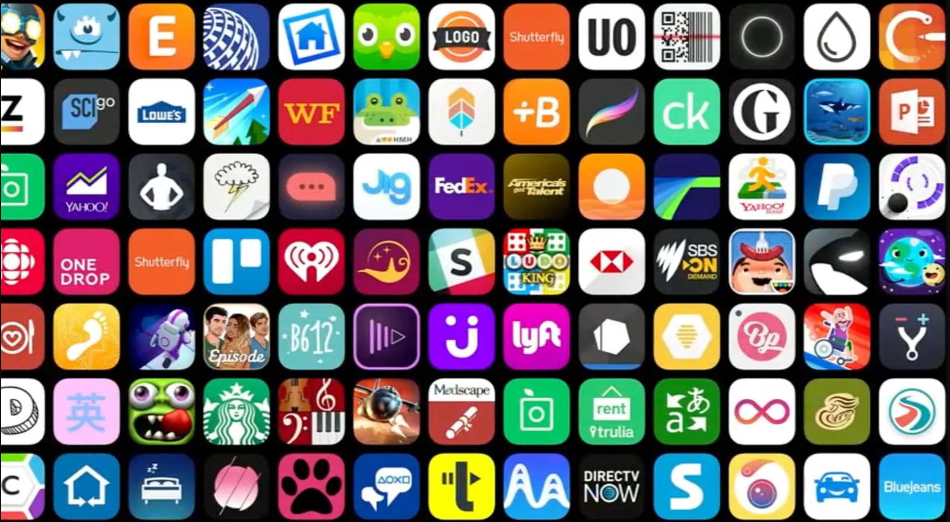
Data Analysis Project Application stores
By: Shady M. Bartakh

Slide 2
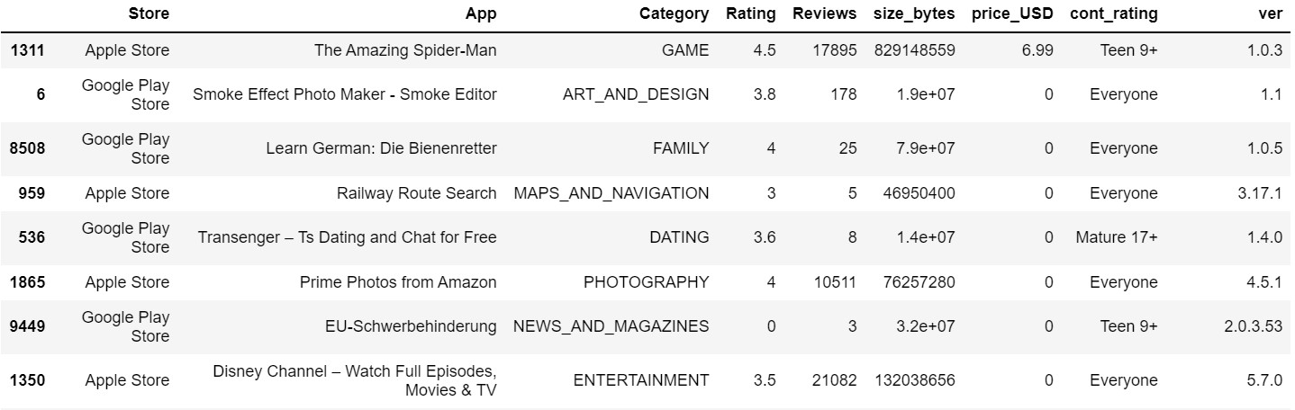
Analyzing from Kaggle datasets
Using two DataFrames (.csv) for both Android & Apple Stores

Slide 3
Cleaning data
NaN values were present in multi rows
Duplicate values
Miss-represented data
Data values with wrong data types
Similar features data split over two tables

Slide 4
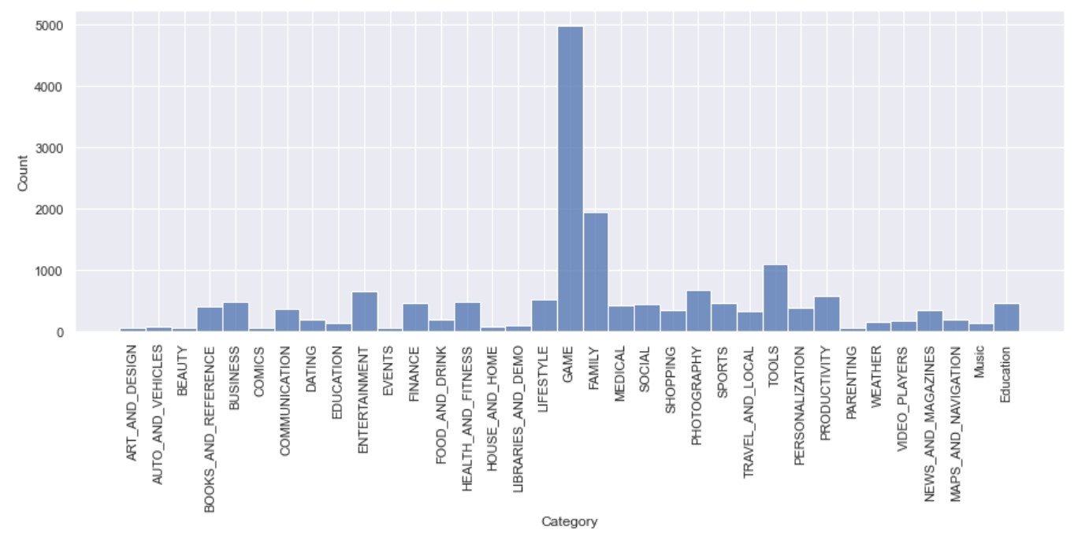
Most frequent application type was Games

Slide 5
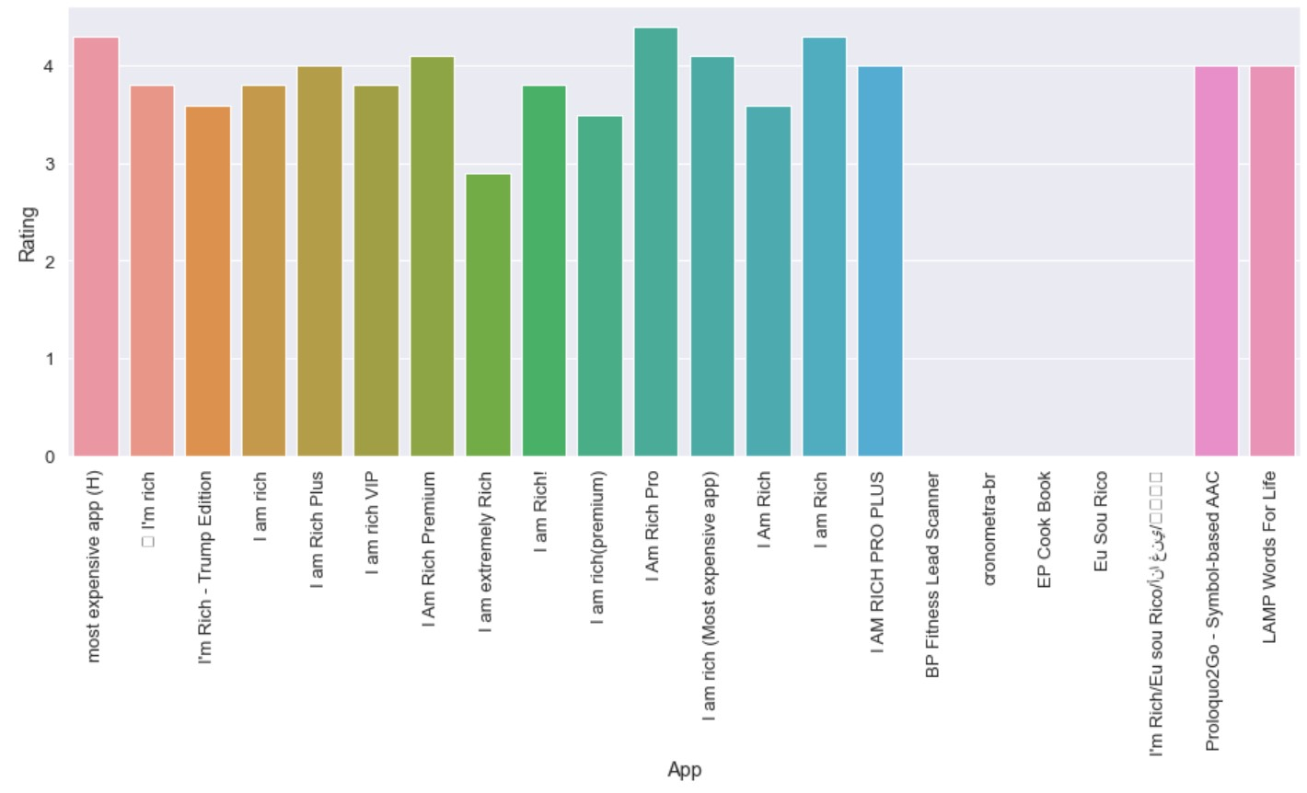
It seems like Many applications need fees for purchasing. Below are the most rated apps over 100 $

Slide 6
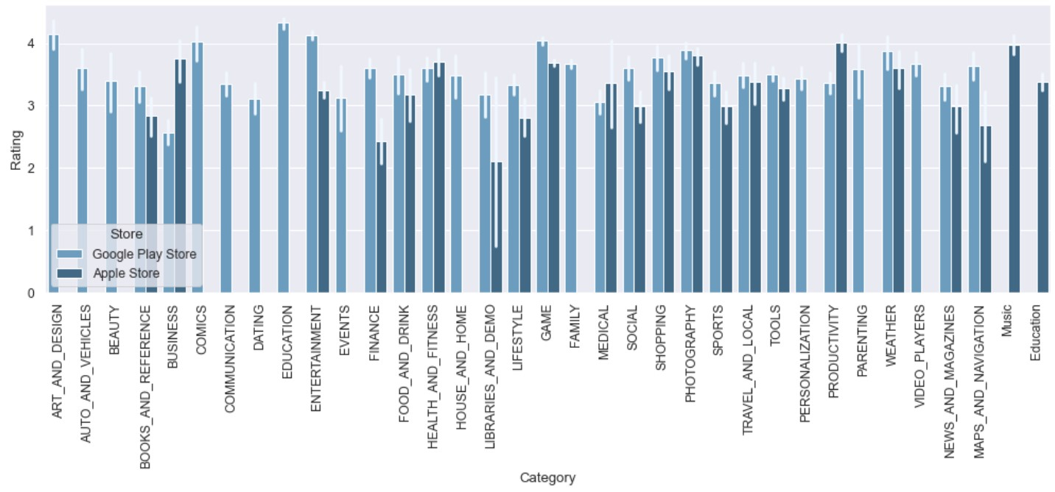
Average rating of apps on each store

Slide 7
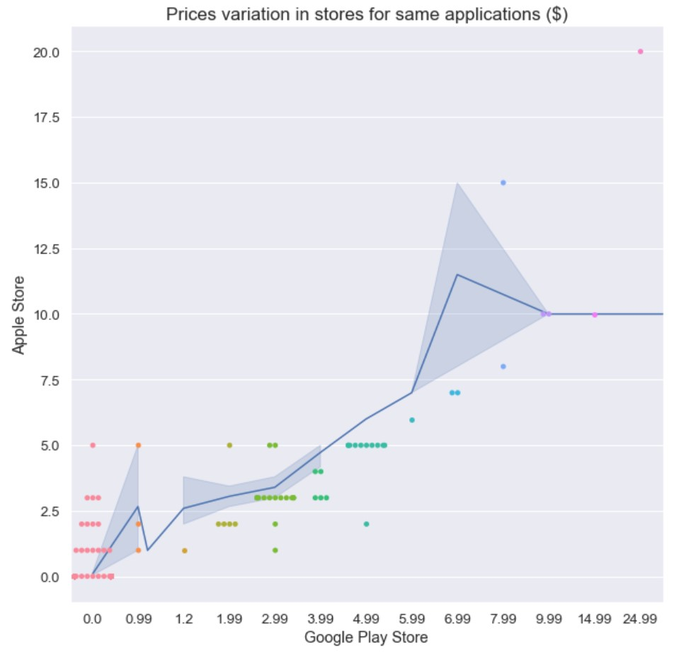
Does Applications’ prices vary per store?
Values are close for both the Android and Apple stores, but maybe some can increase slightly in the App store for Apple.

Slide 8
Data can now be modeled on a ML algorithm to predict future ratings of applications

